Slide 1
Grind Rails Designs
Notes:
These are the slides for teachers to use with their students.

Slide 2
Content and Language Objectives
Content Objective
SWBAT look closely to discern a pattern or structure. (Standards for Mathematical Practice 7)
Language Objective
SWBAT use clear definitions in discussion with others and in their own reasoning. (Standards for Mathematical Practice 6)
SWBAT justify their conclusions, communicate them to others, and respond to the arguments of others. (Standards for Mathematical Practice 3)
Notes:
Below are the full objectives for your reference. I purposely left the content objective vague so that students could “discover” that we were working with slope rather than be told from the beginning.
The language objectives come from SIOP. If the learning process is like going on a trip, then the content objectives are the destination and the language objectives is how you will get there.
Content Objective
Graph linear functions, noting that the vertical change (change in y-value) per unit of horizontal change (change in x-value) is always the same and know that the ratio (“rise over run”) is called the slope of a graph. (California Standards Grade 7 AF 3.3)
Use the equation of a linear model to solve problems in the context of bivariate measurement data, interpreting the slope and intercept. (Common Core State Standards 8.SP.3)
SWBAT look closely to discern a pattern or structure. (Standards for Mathematical Practice 7)
Language Objective
SWBAT use clear definitions in discussion with others and in their own reasoning. (Standards for Mathematical Practice 6)
SWBAT justify their conclusions, communicate them to others, and respond to the arguments of others. (Standards for Mathematical Practice 3)

Slide 3
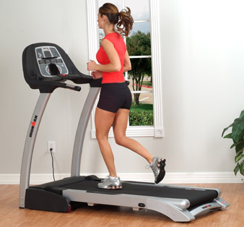
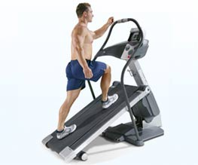
Steepness
Rank these three treadmills from most steep to least steep.
1
3
2
Notes:
Many students have a surprising lack of understanding about what steepness is and what affects it. Accordingly, students are often not prepared to conceptually understand slope. Most will think that a line segment’s length affects its slope. Specifically, they think if three line segments have different lengths but equal slopes, then the longest line segment is the steepest.
As such, students must leave this slide understanding what steepness is. They must also realize that the length of the line segment does not affect its slope.
Make sure to have students explain why they ranked them that way.

Slide 4
What Does Steepness Mean?
On the back of your paper, use words, numbers, and/or pictures to explain what steepness means.
Notes:
This slide can be skipped if students now have sufficient understanding of what steepness means.

Slide 5
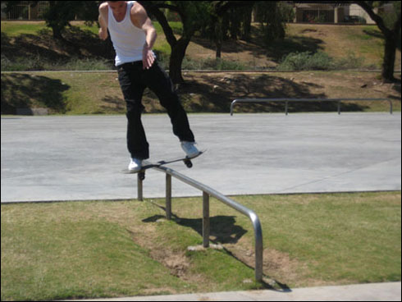
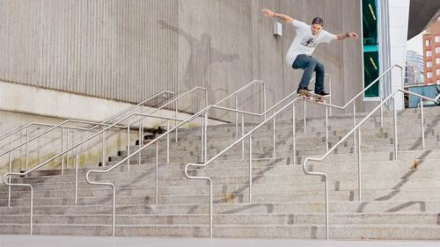
Grind Rails
You have been hired to design three grind rails (handrails) for a new skate park.
To the right are two examples of what these look like in real life.
Notes:
This slide helps build background knowledge for those who are unfamiliar with what grind rails are.
Note that students will be designing a grind rail that is more similar to a steep version of the top one which is a single straight line.

Slide 6
Drawing Grind Rails – Sheet 1
You have been hired to design three grind rails (handrails) for a new skate park. Use the dot paper below to design the grind rails. The grind rails must only use straight lines. Make sure that every grind rail starts and stops at a dot.
Grind Rail #1
Grind Rail #2
Grind Rail #3
Height (in the air)
Height (in the air)
Height (in the air)
Horizontal location (on ground)
Horizontal location (on ground)
Horizontal location (on ground)
Notes:
This is the page to help students draw their grind rails properly. Each of the three grind rails intentionally have errors in them to help students identify them.
Errors:
1 – Curved line
2 – Made of multiple straight lines
3 – Should have negative slope (starting from the top left to bottom right) which is not explicitly stated but helpful for consistency. Also it does not start and stop at a dot.

Slide 7
Which Is Steeper? – Sheet 2
You have been hired to design three grind rails (handrails) for a new skate park. Use the dot paper below to design the grind rails. The grind rails must only use straight lines. Make sure that every grind rail starts and stops at a dot.
Grind Rail #1
Grind Rail #2
Grind Rail #3
Height (in the air)
Height (in the air)
Height (in the air)
Horizontal location (on ground)
Horizontal location (on ground)
Horizontal location (on ground)
Notes:
IMPORTANT:
Students should have prior knowledge of similar triangles once the Common Core State Standards are implemented. Even if they do not, make sure make sure that students understand the connections between these triangles being similar and having the same slope. If they were not similar, they would have different slopes.
If students are struggling to see this, have them use Geoboards.

Slide 8
Which Is Steeper? – Sheet 3
You have been hired to design three grind rails (handrails) for a new skate park. Use the dot paper below to design the grind rails. The grind rails must only use straight lines. Make sure that every grind rail starts and stops at a dot.
Grind Rail #1
Grind Rail #2
Grind Rail #3
Height (in the air)
Height (in the air)
Height (in the air)
Horizontal location (on ground)
Horizontal location (on ground)
Horizontal location (on ground)
Notes:
This slide is useful in dispelling misconceptions about size and slope.

Slide 9
Which Is Steeper? – Sheet 4
You have been hired to design three grind rails (handrails) for a new skate park. Use the dot paper below to design the grind rails. The grind rails must only use straight lines. Make sure that every grind rail starts and stops at a dot.
Grind Rail #1
Grind Rail #2
Grind Rail #3
Height (in the air)
Height (in the air)
Height (in the air)
Horizontal location (on ground)
Horizontal location (on ground)
Horizontal location (on ground)
Notes:
This slide helps students understand how difference in vertical change affects slope.

Slide 10
Which Is Steeper? – Sheet 5
You have been hired to design three grind rails (handrails) for a new skate park. Use the dot paper below to design the grind rails. The grind rails must only use straight lines. Make sure that every grind rail starts and stops at a dot.
Grind Rail #1
Grind Rail #2
Grind Rail #3
Height (in the air)
Height (in the air)
Height (in the air)
Horizontal location (on ground)
Horizontal location (on ground)
Horizontal location (on ground)
Notes:
This slide helps students understand how difference in horizontal change affects slope.

Slide 11
Content and Language Objectives
Content Objective
SWBAT look closely to discern a pattern or structure. (Standards for Mathematical Practice 7)
Language Objective
SWBAT use clear definitions in discussion with others and in their own reasoning. (Standards for Mathematical Practice 6)
SWBAT justify their conclusions, communicate them to others, and respond to the arguments of others. (Standards for Mathematical Practice 3)
Notes:
Review the objectives to see if they were met.

